Slide 1
Sons of God: Knowing the Father
Pursuing the heart of worship
Rev 4
18/06/17

Slide 2
Rev 4 – God’s dwelling in heaven
John 4 – Worshiping God
Worshiping is NOT limited to a place (or time) (v20-21)
Worship must be in spirit and in truth (v22-24)
One sitting on the throne (v2)
Holiness (white, gold, fire) (v3-8)
Praise & Thanksgiving (v9)
Worship (v9-11)

Slide 3
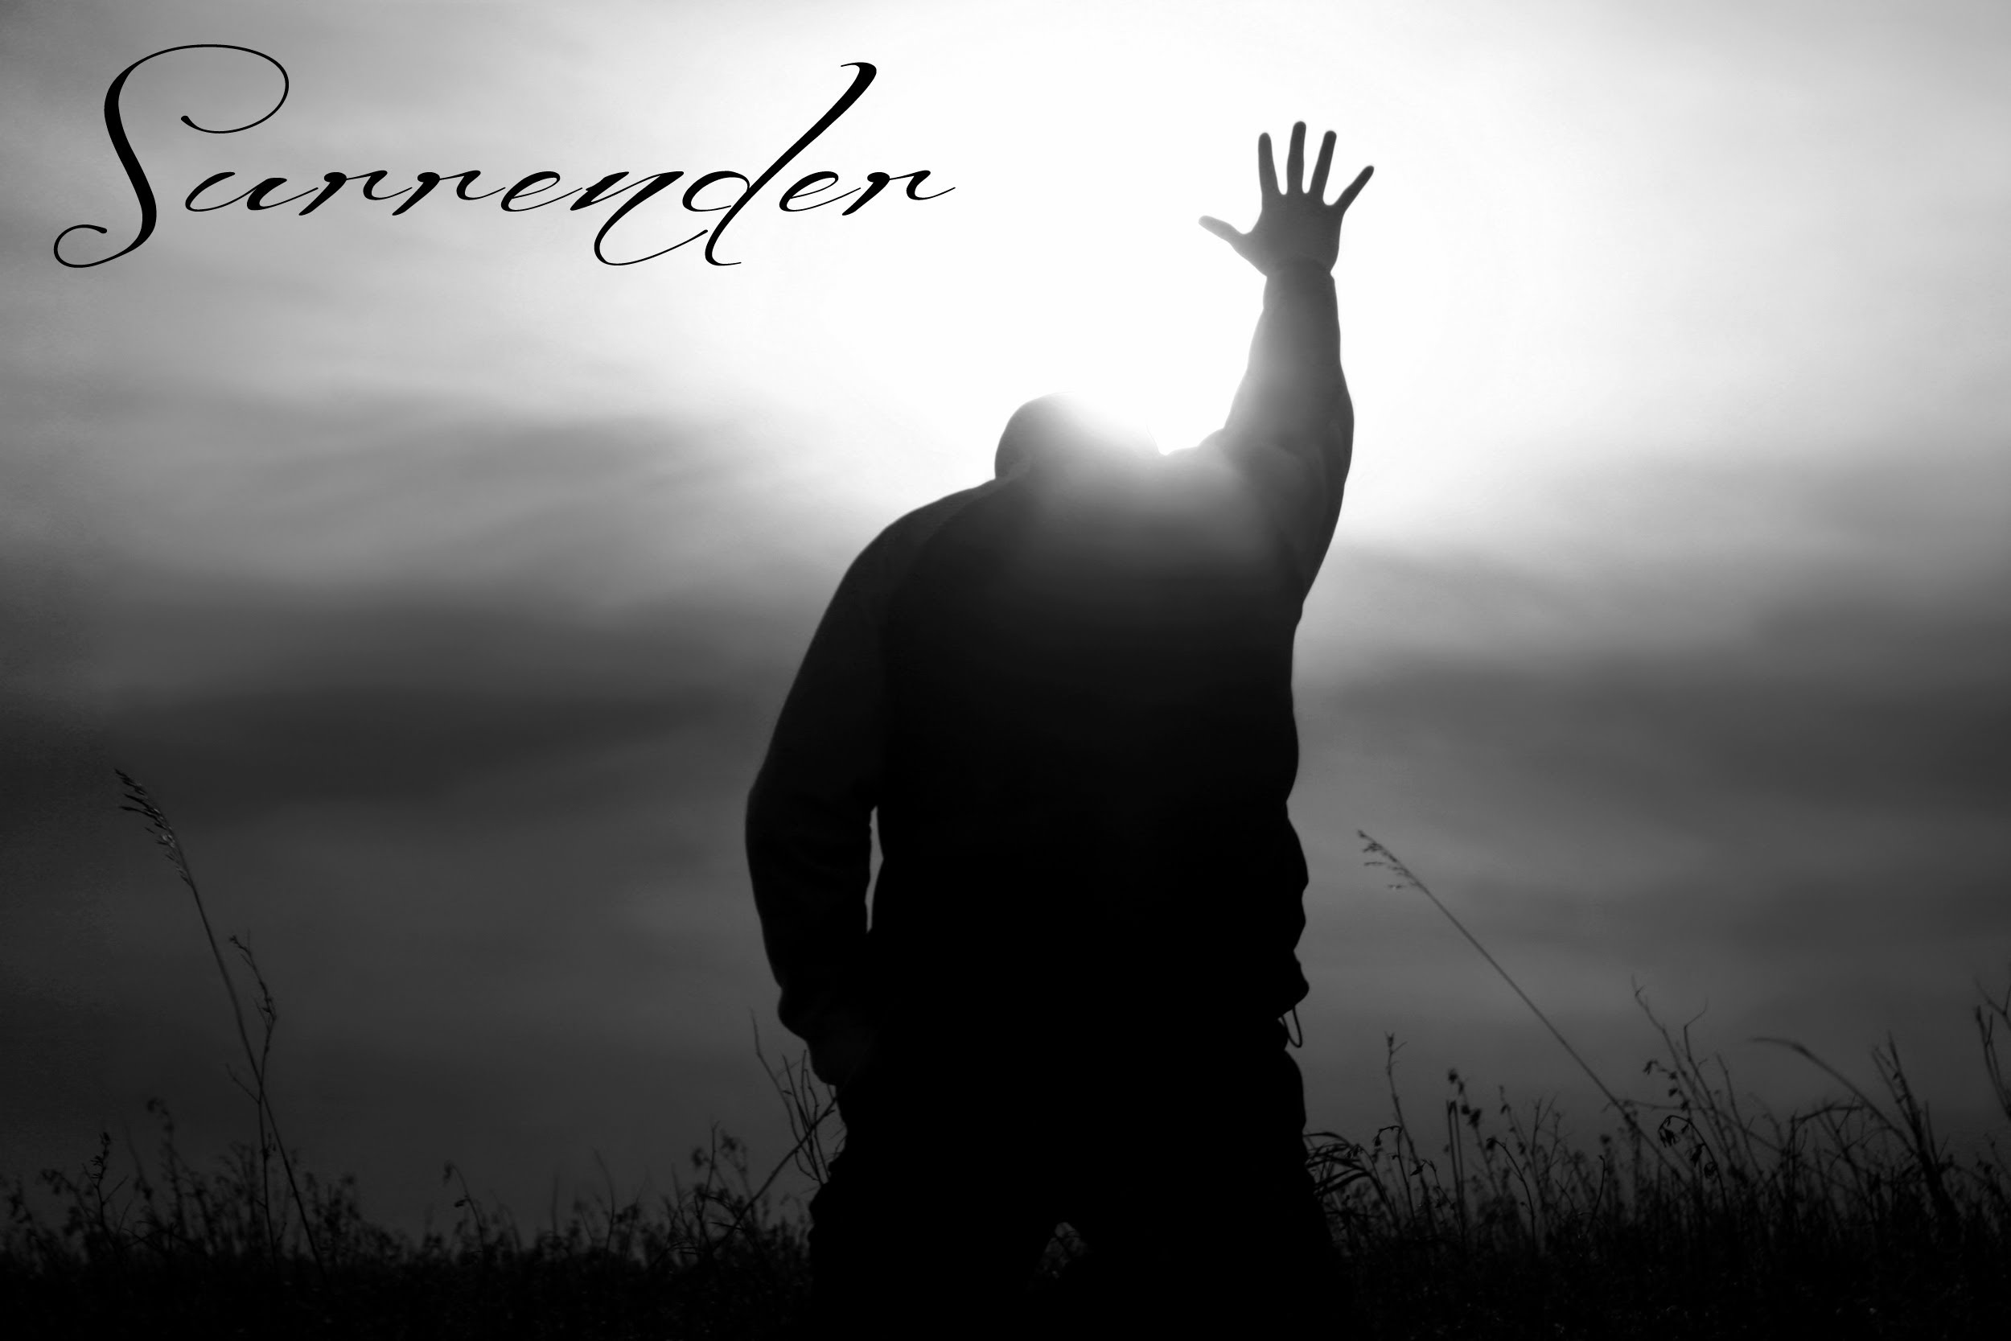
1) One sitting on the throne
Final authority – what influences our thoughts → decisions → actions?
Matt 6:10 – “Let Your
will be done”
Is He the centre of
our life?

Slide 4
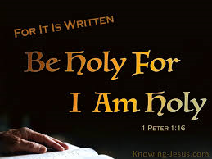
2) Holiness
Set apart for purity (Ps 24:3-5)
  Who may ascend into the hill of the Lord?
  Or who may stand in His holy place?
  He who has clean hands and a pure heart,
  Who has not lifted up his soul to an idol,
  Nor sworn deceitfully.
  He shall receive blessing
  from the Lord,
  And righteousness from
  the God of his salvation.
Manifest His character

Slide 5
2) Holiness
Set apart for purity (2 Tim 2:20-26)
  But in a great house there are not only vessels of gold and silver, but also of wood and clay, some for honor and some for dishonor. Therefore if anyone cleanses himself from the latter, he will be a vessel for honor, sanctified and useful for the Master, prepared for every good work.

Slide 6
2) Holiness
Set apart for purity (2 Tim 2:20-26)
  Flee also youthful lusts; but pursue righteousness, faith, love, peace with those who call on the Lord out of a pure heart. But avoid foolish and ignorant disputes, knowing that they generate strife. And a servant of the Lord must not quarrel but be gentle to all, able to teach, patient, in humility correcting those who are in opposition, if God perhaps will grant them repentance, so that they may know the truth

Slide 7
3) Praise & Thanksgiving (Ps 100:4)
Praise = who He is
Thanksgiving = what He has done
  Make a joyful shout to the Lord, all you lands!
  Serve the Lord with gladness;
  Come before His presence with singing.
  Know that the Lord, He is God;
  It is He who has made us, and not we ourselves
  We are His people and the sheep of His pasture.
  Enter into His gates with thanksgiving,
  And into His courts with praise.
  Be thankful to Him, and bless His name.
  For the Lord is good; His mercy is everlasting,
  And His truth endures to all generations.

Slide 8
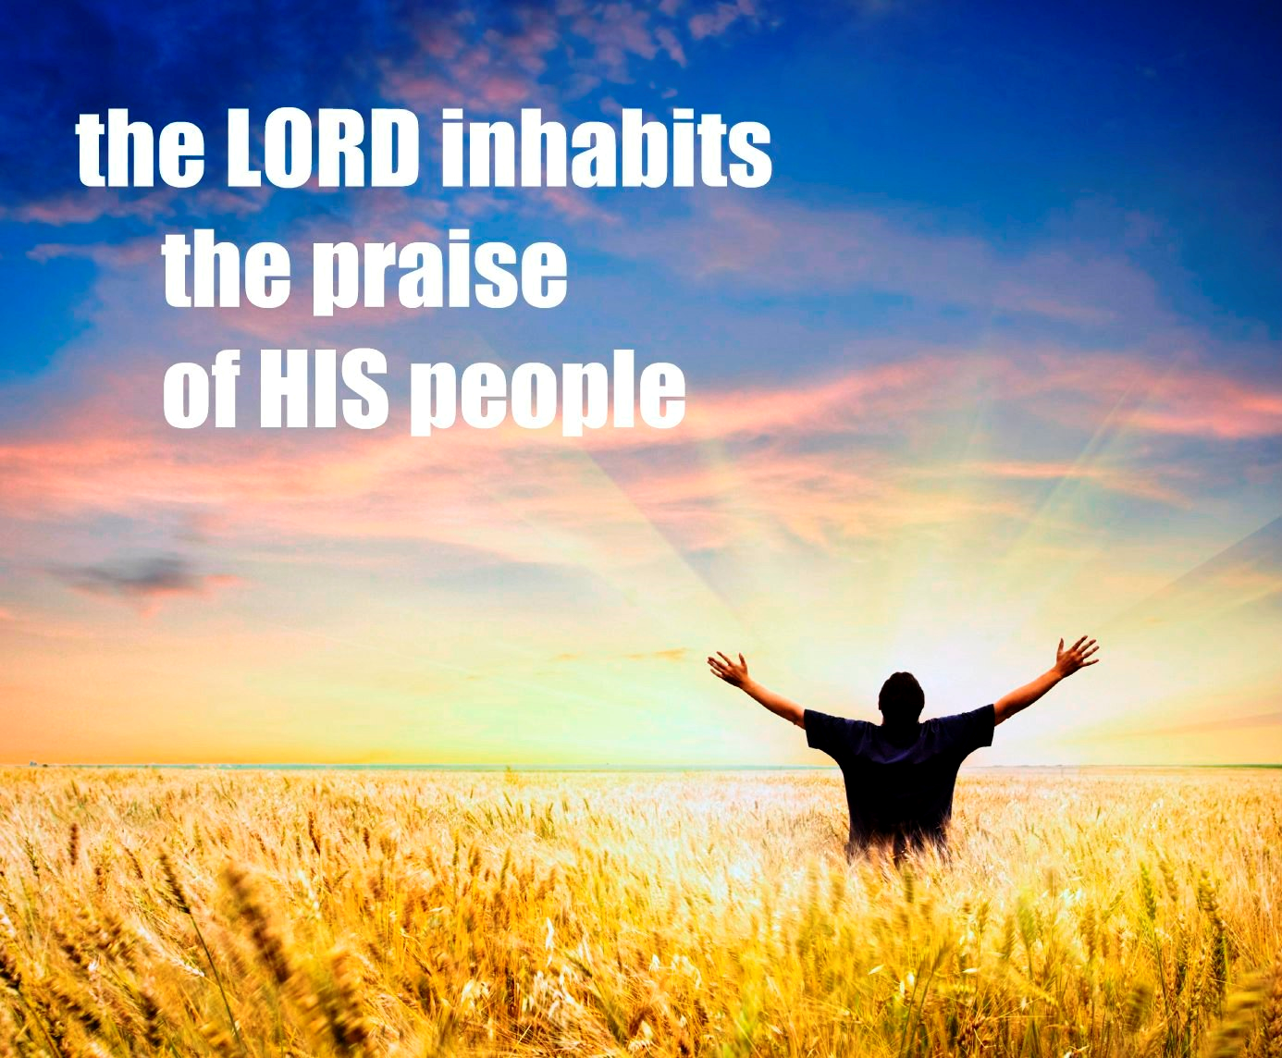
Ps 22:3 - Yet you are holy, enthroned on the praises of Israel.
1 The 5:16-18 Rejoice always, pray without ceasing,
give thanks in all circumstances; for this is the will
of God in Christ Jesus for you.

Slide 9
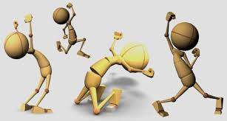
4) Worship (in spirit and in truth)
Amen worship
- Agree and proclaim who He is
ii) Sacrificial worship
- Giving to God (not for man)
iii) Humility worship
- Casts their crowns
- Love expressed (action)

Slide 10
God’s “dwelling” on earth
Heb 3:6 but Christ is faithful over God's house as a son. And we are his house, if indeed we hold fast our confidence and our boasting in our hope.
God’s “dwelling” in us
1 Cor 6:19-20 Or do you not know that your body is a temple of the Holy Spirit in you, whom you have of God? And you are not your own, for you are bought with a price. Therefore glorify God in your body and in your spirit, which are God’s.
CHURCH UNUSUAL!
  A habitation for God to move, manifest and transact freely & fully

